Slide 1
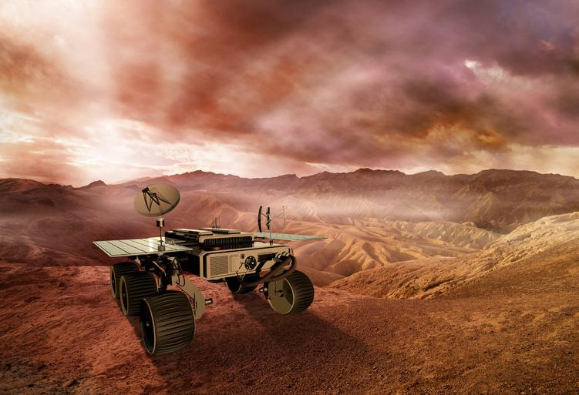

Hot
Science
Living on Mars
Hot Science Cool Activities
www.HotScience.tv

Slide 2
Hot Science Guides
How to Use
Presentation: Share via projector screen or have available to students on individual devices
Reference speaker notes for answer key/ brainstorming suggestions
Worksheet Print-Out: Print a packet for each student to follow along with this presentation

Slide 3
Learning
Objectives
  Use scientific practices to plan and conduct the experiment and design solutions to problems.
  Calculate item volumes to understand how to efficiently pack and compromise among their team.
  Discover the impact of Mars’ climate and conditions in relation to the items packed.
1

Slide 4

Living On Mars
1

Slide 5
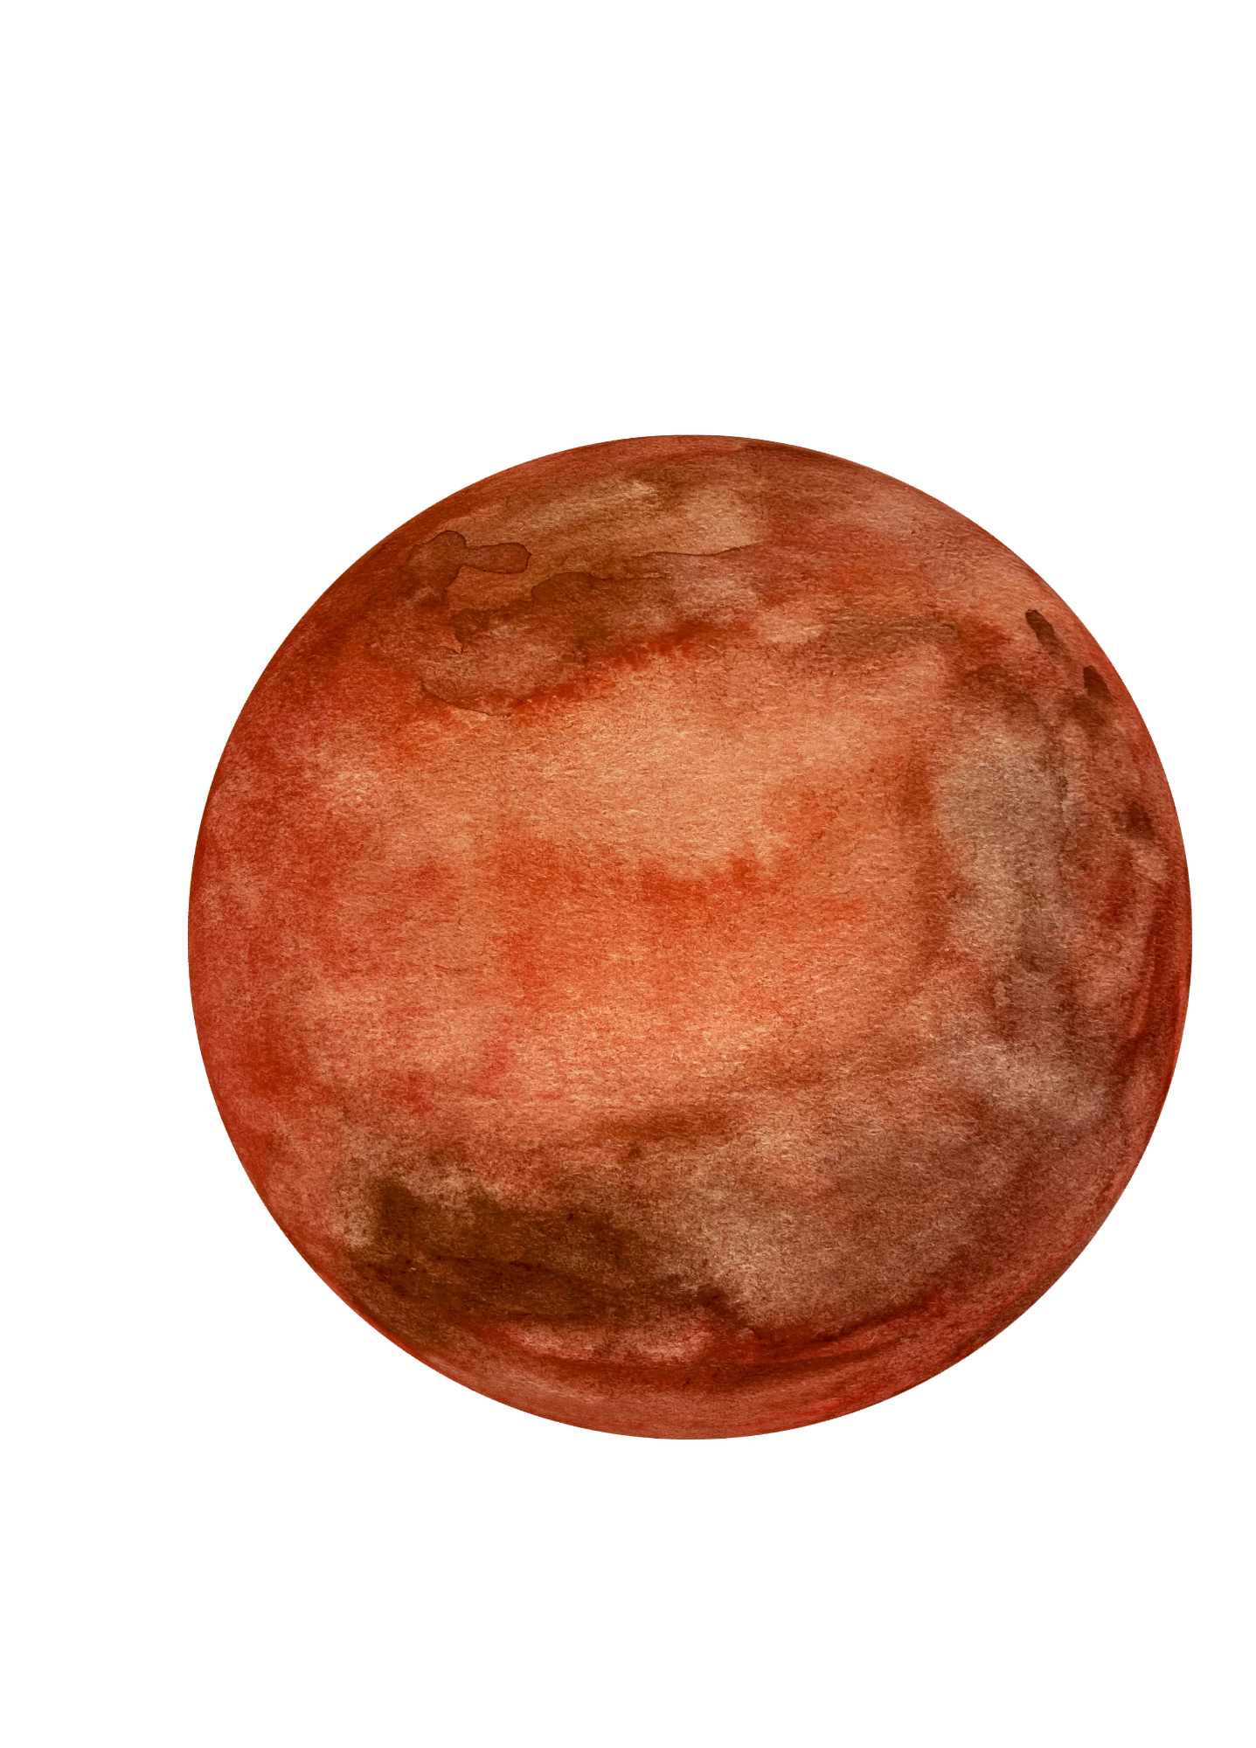
About Mars
Mars has been the subject of scientific curiosity for hundreds of years. For decades, we’ve only got a handful of pictures from the few successful missions.
You and a few other astronauts have been chosen to be the first humans to set foot on Mars! The trip will take approximately 2.5 years, and morale will be tough to maintain. As Dr. Joe Levy says, Mars could answer many questions we have about life and the universe.
2

Slide 6
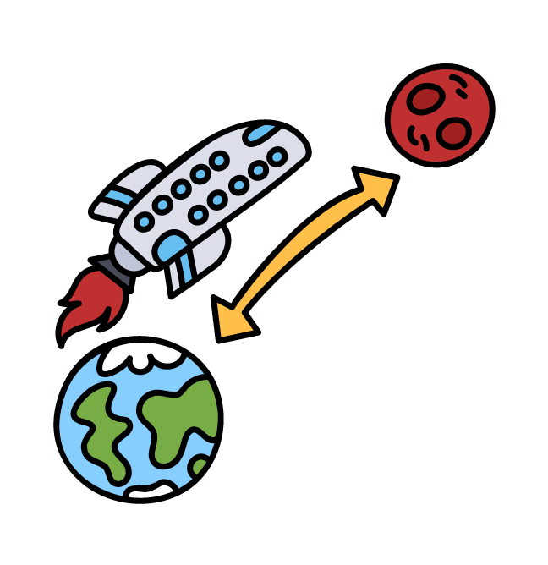
Prepare
for Mars
Your Challenge
Pack everything your team is going to need for a trip to Mars in a box.
Materials
Calculator (optional)
Phone or tablet
Cardboard box (shoe box or any other size)
Ruler
Personal items for your Mars trip
3

Slide 7

Packing
Form groups of 3-4. Each astronaut field team gets one box to pack with items to keep everyone happy and comfy.
Decide what personal items or supplies to bring (your phone, favorite books, snacks). Find these items to calculate their volumes or look up their dimensions online.
Calculate the volume of each item and subtract it from the total box volume. For items with irregular shapes (like pieces of clothing), select the closest volume shape.
Try to not leave empty spaces in your box! Empty space won’t help you when morale is low.
Things to Consider
4

Slide 8

Next Steps
This mission to Mars is going to cost billions of dollars! Each pound costs $10,000 to transport through space. You want to pack your box in the most cost-efficient way possible.
Check the items you packed and see what you can remove or change to save space and cost.
Mars doesn’t have any electricity and the limited amount of electricity you might be able to generate will be used for research equipment.
NASA will provide essential items like water, food, research equipment and other materials needed for basic survival.
5
Notes:
Some items they may consider packing like handheld devices, won’t work long term due to limited electricity. Encourage students to bring items that would raise morale for everyone in their group (e.g., compromising on a book they could share, a custom mixed bag of favorite candies). Smaller items may work better for individual use but larger items may have to be shared.

Slide 9
How do we decide what items are the most important vs. least important? How did you compromise with the space available?
What can you bring to help keep up morale (things everyone will enjoy)?
What are some things that weren’t mentioned above but might need to be considered when packing your box?
Did you take into consideration Mars’ environment and climate when packing your box? If you didn’t how do the items in your box change as a result?
Describe a scenario in your regular life where you may apply this type of methodology to packing (ex. packing a cooler).
Answer Brainstorm
6
Notes:
Explore as a class how each group of students compromised on the types of space used per student or what types of strategies they implemented.
Popcorn with each group to share out some morale building items.
Some items that may be considered: (Letters from loved ones, photos, books, music, a cozy shared blanket, small momentos, art supplies, a board/card game, national memorabilia, religious/cultural items).
Since this is a much longer trip than one to the International Space Station (ISS), students may want to consider Mars’ extreme climate (average temperature of -80F (-60C). It’s atmosphere is thin, meaning once they are there they will need protection from radiation and dust storms. They may want to consider having items that are durable (paper playing cards vs. plastic), lightweight, and compact. Items like photos or books need to be carefully stored to make sure they avoid damage from dust or freezing temperatures.
Packing a suitcase for a trip, organizing a backpack for school, organizing their locker, arranging groceries in a bag, storing items in a car trunk, storing seasonal items, moving or shipping items, fitting furniture in a room, planning a picnic (fitting items in a cooler).

Slide 10
Bonus
Question
What kind of specialists would you need on your field team for your journey to and on Mars?
Remember: you and your team have to make a functional survival team!
7
Notes:
Botanist: Studies and manages plant life, which is crucial for growing food and producing oxygen in a controlled environment.
Geologist: Examines the Martian terrain, rocks, and soil to understand the planet's history and potential resources.
Commander/Pilot: Leads the mission, makes critical decisions, and navigates the spacecraft.
Chemist: Analyzes the chemical composition of the Martian environment, develops methods for creating fuel and other materials, and ensures safe handling of chemicals.
Medical Doctor: To handle any health issues or emergencies that arise during the mission.
Nutritionist: To ensure the crew's diet is balanced and they are getting all necessary nutrients.
Mechanical Engineer: To maintain and repair the spacecraft and equipment.
Communications Specialist: To manage communications between the spacecraft and mission control on Earth.
Robotics Specialist: To handle any robotic equipment or drones used for exploration and research.
Astrophysicist: To study and analyze the space environment and any potential hazards.
Hydrologist: To study and manage water resources, which are critical for survival on Mars.
Electrician: To handle electrical systems and ensure all equipment is functioning properly.
Computer Scientist/IT Specialist: To manage software, data systems, and any computational needs.

