Slide 1
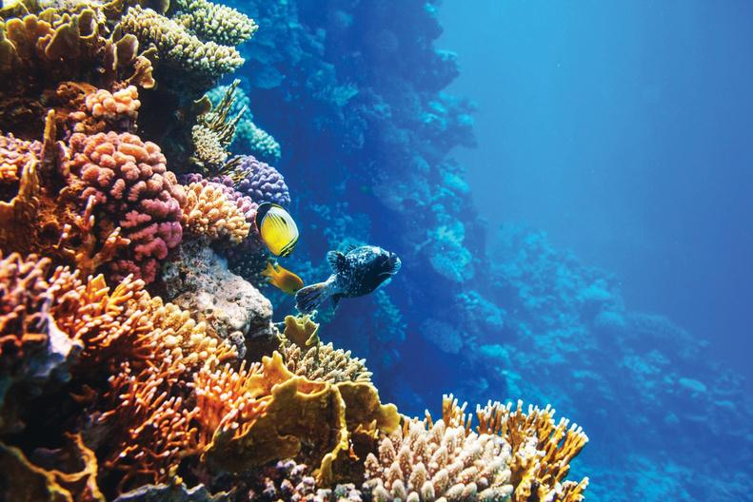
Hot
Science
Rethink the Shark
Hot Science Cool Activities
www.HotScience.tv

Slide 2
Hot Science Guides
How to Use
Presentation: Share via projector screen
Reference speaker notes for answer key/ brainstorming suggestions
Worksheet Print-Out: Print a packet for each student to follow along with this presentation

Slide 3
Learning
Objectives
  Recreate and observe the Doppler Effect through experimentation, identifying how changes in sound frequency relate to movement.
  Explain how scientists apply the Doppler Effect to collect data.
  Understand how satellites use the Doppler Effect to track the movement of sharks and other animals through radio waves.
  Understand how the Doppler Effect applies across different types of “waves” or frequencies.
1

Slide 4
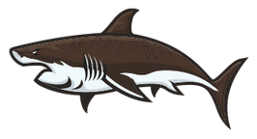
About
Sharks
Sharks are always on the move in the vast oceans. Satellites orbiting thousands of miles above Earth collect information from tags attached to the sharks when they come up to the surface. But how do these trackers work? One technique that scientists can use to track an animal’s position from space uses a phenomenon known as the Doppler Effect.
1

Slide 5
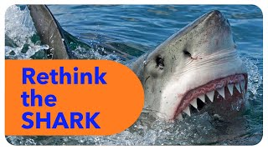
Rethink
the Shark
2

Slide 6

Your
Challenge
Recreate the Doppler Effect and discover how shark tracking works! On your phone or tablet, go to the following link:
https://youtu.be/Bh2YppyFY3E
3

Slide 7
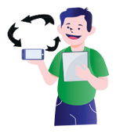
Steps
Play the video on your phone or tablet with the sound on high.
At ear level, quickly spin your phone in a circle.
Notice how the sound changes as you spin the phone.
Now, spin the phone very slowly and observe what happens.
Your
Challenge
What’s Happening?
The pitch of the sound changes! This is the Doppler Effect. When the phone moves towards your ear, the sound has a higher pitch (higher frequency). When the phone moves away, the sound has a lower pitch (lower frequency).
4

Slide 8
What is the Doppler Effect?
Doppler
Effect
Waves more spread out
=
Lower Frequency or Pitch
Waves bunched up
=
Higher Frequency or Pitch
Device is emitting waves, but is not moving. The waves, or frequency, are the same distance apart in all directions.
Device producing the waves is moving to the right.
5

Slide 9
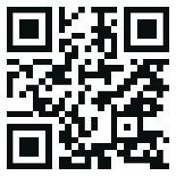
Shark
Tracking
Scientists use the Doppler Effect to track sharks. By comparing the frequency of the sound received to the original frequency, they can figure out the shark’s location. This data, combined with computer software, allows scientists to track sharks all over the ocean.
Your Challenge
Go to this link and track some sharks yourself!
https://www.ocearch.org/tracker/
6

Slide 10
Doppler
In Action
Work together to brainstorm other instances or technology that use the Doppler Effect!
7
Notes:
Ambulance Siren:
When an ambulance passes by, the pitch of its siren sounds higher as it approaches and lower as it moves away. This change in pitch is due to the Doppler Effect.
Train Whistle:
Just like the ambulance siren, a train’s whistle sounds higher-pitched as it approaches and lower-pitched as it moves away.
Police Radar:
Police use radar guns to measure the speed of cars. The radar gun sends out a signal that reflects off the moving car. The change in frequency of the reflected signal helps calculate the car’s speed.
Weather Radar:
Meteorologists use Doppler radar to track storms. It measures the speed and direction of raindrops, which helps predict the weather.
Bats:
Bats use echolocation to navigate and find food. They emit high-frequency sounds that bounce off objects, and the Doppler Effect helps them determine if an object is moving towards or away from them.
Astronomy:
Astronomers use the Doppler Effect to study stars and galaxies. By observing the changes in the frequency of light from these celestial objects, they can determine if they are moving closer or further away from Earth.
Ultrasound Imaging:
Doctors use ultrasounds to see inside the body. The Doppler Effect helps measure the flow of blood and other fluids, showing how fast and in which direction they are moving.

