Slide 1
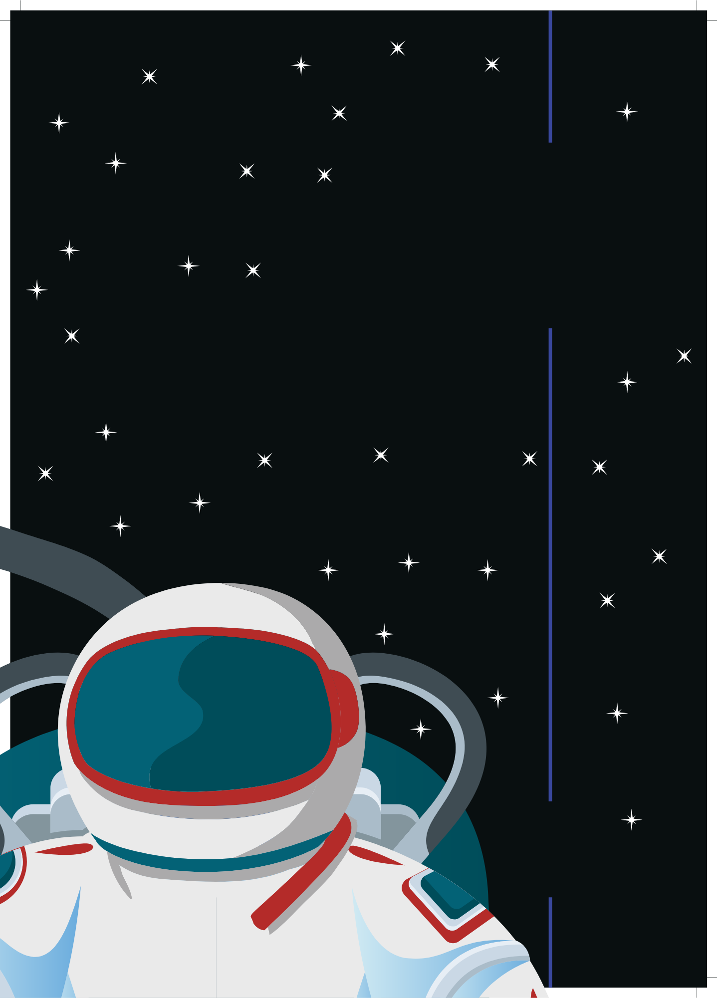
Hot
Science
Hot
Science
Space Pollution
Hot Science Cool Activities
Hot Science Cool Activities
www.HotScience.tv

Slide 2
Hot Science Guides
How to Use
Presentation: Share via projector screen
Reference speaker notes for answer key/ brainstorming suggestions
Worksheet Print-Out: Print a packet for each student to follow along with this presentation

Slide 3
Learning
Objectives
  Understand how space pollution is created and how it affects satellites and human activity in space.
  Investigate how the mass and speed of objects influence the size of impacts.
  Explain how small space debris, like a speck of paint, can cause significant damage by connecting experimental results to real-world examples in space.
1

Slide 4
Small Objects
Big Impact
Houston, we have a problem!
Many of the conveniences we enjoy require satellite technology, such as accessing the Internet. However, collisions between man-made objects in space send thousands of large and tiny pieces of debris floating in orbit, which can crash into other satellites.
Even small, light pieces of debris can be fatal.
1

Slide 5
Pre-Lab
Discussion
Tell Us What You Know About Impact
When two objects collide, they create an impact. What is “impact”?
What light objects (objects with a small mass) can create a collision with a lot of impact?
What sort of things do you think create pollution in space?
How do you think space debris could be harmful to humans or other man-made space objects?
2
Notes:
Impact refers to the force or shock that occurs when two objects collide. It is the result of the energy transfer between the objects at the moment of collision. The magnitude of the impact depends on the speed (velocity) of the objects, their masses, and how much they deform or transfer energy during the collision.
Light objects with high velocity can still create a significant impact. Some examples include:
Micrometeoroids: Tiny, dust-sized particles moving through space at very high speeds
Bullets: On Earth, bullets are relatively small and light, but they can cause serious damage due to their high speed.
Hail: Some hail can be small and light, but since it falls from such a great height at high speeds it can cause significant damage.
Other ideas: Golf balls, baseballs/softballs, raindrops, shrapnel, wind-blown sand
Potential Answers:
Defunct satellites: Old, non-functioning satellites that are no longer operational but remain in orbit.
Rocket debris: Pieces of rockets, including spent stages or remnants from rocket launches.
Fragments from collisions: When satellites or other objects collide, they can break into smaller pieces, contributing to space debris.
Discarded tools or equipment: Occasionally, astronauts or space missions lose small objects during spacewalks or construction, adding to space debris.
Potential Answers:
Damage to spacecraft: High-speed collisions with space debris, even tiny fragments, can puncture or severely damage spacecraft, satellites, or the International Space Station (ISS).
Risk to astronauts: Debris could pose a serious threat to astronauts during spacewalks or missions. A small piece of debris could penetrate a space suit or spacecraft hull, causing injuries or critical damage.
Loss of satellites: Collisions with space debris can disable or destroy expensive and essential satellites, disrupting communications, weather forecasting, GPS, and other vital services.
Kessler Syndrome: This is a scenario where debris from one collision creates a chain reaction of further collisions, leading to more space debris, potentially making parts of Earth’s orbit unusable for future missions.

Slide 6
Small Objects
Big Impact
Your Challenge
How could light objects create damage? Create a simulation testing the impact of objects of different
masses going at different speeds in a collision.
Materials
Bag of flour
Small cardboard box
Measuring tape
Stopwatch
Scale
1 tiny marble
1 large marble
3

Slide 7
Group
Of Four
Overview
In a group of 4, you will be testing the impact that different types of marbles have when they collide with the flour. You will record data on the mass of the marbles and how big a dent the marbles make in the flour. Afterward, you will watch a Hot Science video by Dr. Moriba Jah explaining the dangers of space pollution. Then, you will apply what you have learned about the impact that small and large marbles make in a collision to the types of crashes that happen in space.
4

Slide 8
Set Up
Form groups of 3-4, and assign each learner one of the roles. In a group of 3, one learner should get the roles of both measurer and notetaker.
  Ball dropper: Drop or throw the ball downward into the flour.
  Measurer: Measure everything that is specified in the instructions, and report these measurements to the notetaker.
  Notetaker: Write down all data reported from the measurer into the lab data sheet.
  Equipment Preparer: Make sure that all lab equipment is accounted for and that flour is smoothed each time.
The equipment preparer should pour flour into the box until it reaches ¾ of the box’s depth.
Things to
Consider
5

Slide 9
Lab Instructions
Measure the tiny marble’s mass in grams and record it on the note sheet.
Drop the marble from 1.5 meters above the flour box.
Measure the depth of the hole the marble makes, and record your observations on your datasheet.
Reset the flour so that it is flat.
Again, hold the tiny marble 1.5 meters above the flour.
Now, throw it downward with a significant amount of force.
Measure the depth of the hole the marble makes, and record record your observations on you datasheet.
Repeat steps 1-7 with the large marble.
Key
Steps
6

Slide 10

Space
Pollution
7

Slide 11
Answer
Brainstorm
How did you measure the “impact” that the marbles made with the flour? Select one.
  The mass of the marble
  The height at which the marble was dropped or thrown
  The depth of the hole that the marble made in the flour
In your experiment with the tiny marble, did the marble that was dropped make a bigger “impact” than the marble that was thrown? Explain your reasoning using the data from the datasheet.
8
Notes:
C.
The tiny marble that was thrown likely made a bigger impact than the marble that was dropped. This is because when the marble was thrown, it had additional velocity from the force applied to it. The greater the speed of the marble upon hitting the flour, the more kinetic energy it had, which resulted in a deeper hole in the flour compared to the marble that was simply dropped from the same height.

Slide 12
Answer
Brainstorm
Compare the large marble that was dropped with the tiny marble that was dropped. Which one made a bigger impact? Explain your reasoning using the data from the datasheet.
Which two factors affected the impact that the marbles had on the flour? Think about your answers to the questions above.
9
Notes:
3. The large marble likely made a bigger impact than the tiny marble when both were dropped from the same height. This is because the larger marble has more mass, and therefore, more potential energy before it is dropped. When it hits the flour, the larger marble transfers more energy due to its greater mass, resulting in a deeper hole or a larger impact. The data from the datasheet should show that the large marble created a deeper hole compared to the tiny marble.
4. Velocity and Mass—both influence the amount of kinetic energy the marbles transfer to the flour, determining the size and depth of the impact.
Velocity: The marble that was thrown had a higher velocity than the one that was dropped, resulting in a greater impact. The faster an object moves, the more kinetic energy it has when it collides with another object (in this case, the flour).
Mass: The larger marble had more mass than the tiny marble, and therefore, created a bigger impact when dropped. The more mass an object has, the greater its potential energy, and the more force it exerts upon impact when dropped from the same height.

Slide 13
Post
Lab
According to Dr. Jah, why is space pollution dangerous to humans and satellites?
What sort of debris can space collisions create?
Dr. Jah says that specks of paint can be fatal to humans, and they can critically damage satellites. However, a speck of paint is millimeters in length (about how tall an ant is)! Using the results from your lab, explain how an object as light and tiny as a speck of paint could cause such damage.
10
Notes:
Collision risks, damage to spacecraft, threat to astronauts, Kessler syndrome (chain reactions)
Machinery or satellite fragments, micrometeoroid fragments, paint flecks, tools
Objects in orbit, including tiny paint flecks, travel at extremely high speeds. Despite their small size, their high velocity means they have a lot of kinetic energy. This energy translates into a powerful impact when they collide with other objects.

